Slide 1
Guidelines for Modelling
Chapter 6

Slide 2
Guidelines for Modelling
The Modelling Process
    Modelling as a Transformation Process
    Basic Modelling Activities
    Types of Modelling Actions
Guidelines for Modelling .
    What to Capture in a Model
    Modelling and Abstraction
    Structuring Models and Visualisations
    Constructive Use of Modelling Breakdowns
Readability and Usability of Models .
  Reducing the Visual Complexity of Models
  Representation Conventions

Slide 3
1. The Modelling Process
Models focus on specific aspects of the real world, based on the purpose for which the model is created
In enterprise architecture, modelling typically involves creating abstract representations of enterprises: the business processes involved, the IT-infrastructure, as well as the relations between them.
An enterprise architect gathers relevant information and transforms this into a model

Slide 4
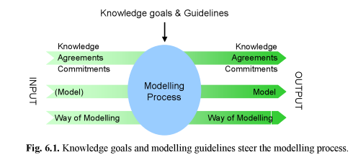
1.1 Modelling as a Transformation Process

Slide 5
1.1 Modelling as a Transformation Process
Communication also has its underlying goal: the participants are to introduce, agree on, and commit to some knowledge representation.
This means that the model that is the result of a modelling process is not the ultimate goal, and not even the only product of that process

Slide 6
1.2 Basic Modelling Activities
We distinguish the following activities in a modelling process:
  Establishing the purpose, scope and focus.
  Selecting one or more viewpoints
  Creating and structuring the model
  Visualising the model
  Using the model
  Maintaining the model

Slide 7
1.3 Types of Modelling Actions
How concepts and relations are handled during modelling
Modelling actions are operations on concrete concepts and relations from the domain that is being modelled.
These concepts and relations can be considered instances of the concepts and relations that are defined in the ArchiMate language.

Slide 8
1.3 Types of Modelling Actions
Introduce a candidate element in the model.
Refine an element in the model:
  Classify the newly introduced (candidate) element.
  Provide a description of the element in another way than adding more elements, for instance by:
    Adding internal detail to an element
    Writing a definition or gloss kept outside the model
    Nesting models

Slide 9
1.3 Types of Modelling Actions
Abandon a model element
Abstract from a concept or relation
Translate an element.
Document modelling actions.

Slide 10
2. Guidelines for Modelling
The main guideline for modelling results from our notion of modelling as a goal-driven activity is the following:
    A model has to provide answers to questions.
    Make a clear distinction between a model and its visualisations.
    Applying Grice’s Maxims to enterprise architecture

Slide 11
2. Guidelines for Modelling
Maxim of Quantity:
Make your model as informative as necessary.
Do not make your model more informative than necessary.
Maxim of Quality:
Do not model what you believe to be false.
Do not model that for which you lack adequate evidence.
Maxim of Manner:
      Avoid obscurity of expression.
      Avoid ambiguity.
      Be brief (avoid unnecessary concepts and relations).
      Be orderly.

Slide 12
2. Guidelines for Modelling
Model iteratively.
Model for dynamics.
Be economical in models.
Be economical in views.
Make concepts recognisable.
Make structures recognisable.
Make a model consistent
Keep related models consistent.
Make models as correct and complete as needed.
Treat different concerns orthogonally.

Slide 13
2.1 What to Capture in a Model?
Select the design viewpoints that match your objective
Focus: Only include those elements in the model that directly contribute to the re-alisation of the modelling objective.
Neglect matters of secondary importance and exceptions.
Do not be afraid to abandon model elements.
Discuss stable, intermediate versions of the model with the stake-holders.
Start modelling from a single element.

Slide 14
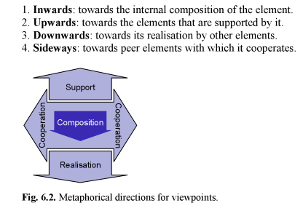
2.1 What to Capture in a Model?

Slide 15
2.2 Modelling and Abstraction
Through the use of ab-straction levels you can first capture the key concepts and key relations in an enterprise architecture model, before providing more details.
  First capture key concepts and key relations at a high level of ab-straction.
  Use a limited number of predefined abstraction levels. Define abstraction levels based on the modelling goals.
  Keep abstraction levels consistent.

Slide 16
2.3 Structuring Models and Visualisations
When a model consists of many concepts and relations, structuring a model helps to reduce the visual complexity of the model, which makes it easier for your stakeholders to recognise and understand your model.
Architecture models may contain different types of structure. Commonly used structural dimensions include:
    functionality: functional decomposition;
      time: temporal structure, data flow, control flow;
usage: dependencies, call graphs;
location: physical distribution;
data structure: type/class hierarchies;
work: units of implementation, module structure.

Slide 17
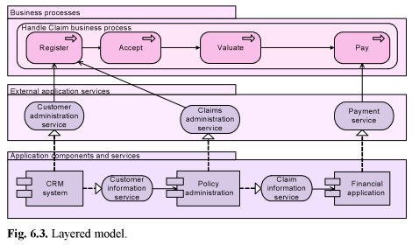
2.3 Structuring Models and Visualisations
some of the most important and widely used structuring principles:
  Make a model as self-explanatory as possible.
  Separate internal and external behaviour.
  Use layers.

Slide 18
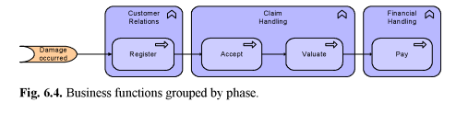
2.3 Structuring Models and Visualisations
Group by phase

Slide 19
2.3 Structuring Models and Visualisations
Group by product or service.
Group by information used.
Group by physical distribution.
Separate independent parts.

Slide 20
2.4 Constructive Use of Modelling Breakdowns
In a modelling process, breakdowns become evident when for some reason a stakeholder does not properly understand the model.
Most importantly you should check for readability and effect.

Slide 21
2.4 Constructive Use of Modelling Breakdowns
Check for Readability : We distinguish the following readability breakdowns:
    The model is not understood
    The model is understood in the wrong way
    The model has no intuitive structure for the receiver.
Check for Effect
    The model or architect lacks status.
    The model has a true but unwanted message.
    The model is irrelevant:
    The model contains superfluous elements:
    The model is too complex.
    The model is too vague.
    The model is not sufficiently complete.
    The model is not true.

Slide 22
3. Readability and Usability of Models
The prime purpose of enterprise architecture models is to capture and communicate key functions and key relations of different domains relevant for enterprises.
As such, these models have to be readable and usable
While creating models, you should aim for models with a limited complexity, by reducing:
    − the number of elements in the model;
    − the number of types of elements in the model;
    − the number of relations depicted in the model.

Slide 23
3.1 Reducing the Visual Complexity of Models
Reducing the visual complexity of models is primarily achieved by limiting the number of concepts and relations that are visible in a model
Having different views of models is one means to reduce the visual and conceptual complexity
Another solution is the use of abstraction.

Slide 24
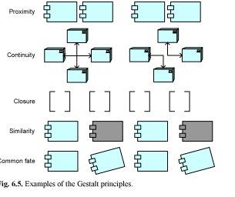
3.1 Reducing the Visual Complexity of Models

Slide 25
3.2 Representation Conventions
Use of Layout
  Representation conventions can be applied to increase the ease of understanding models
    Use white space.
    Distinguish between normal and exceptional cases.
    Avoid crossing lines.

Slide 26
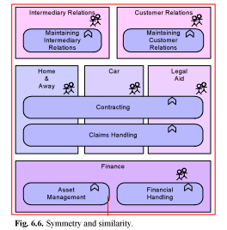
3.2 Representation Conventions
Use symmetry to stress similarities.

Slide 27
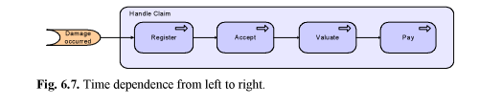
3.2 Representation Conventions
Model time dependence from left to right.

Slide 28
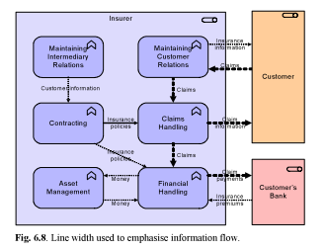
3.2 Representation Conventions
Use of Symbols:
  Use similar shapes for similar concepts.
  Use line width to stress important relations.

Slide 29
3.2 Representation Conventions
Use of Colour :
  Use colour for emphasis.
  Use colour for similarity.
  Use colour to convey emotions.
  Limit the number of colours.
Use of Text :
  Use domain-specific terminology.
  Use naming conventions.

